Slide 1

Gameshows Quiz

Slide 3
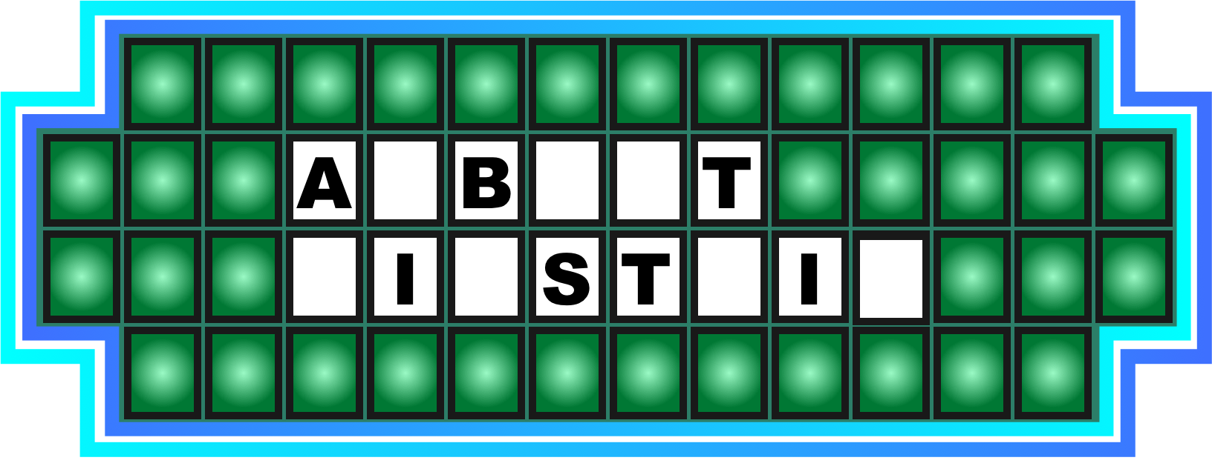
1. A genius

Slide 4
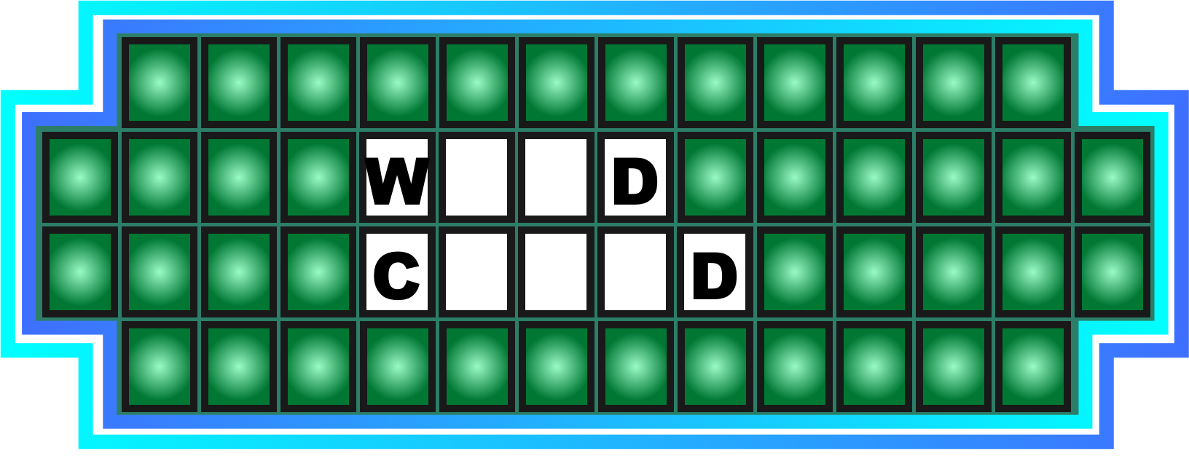
2. Crazy kid

Slide 5
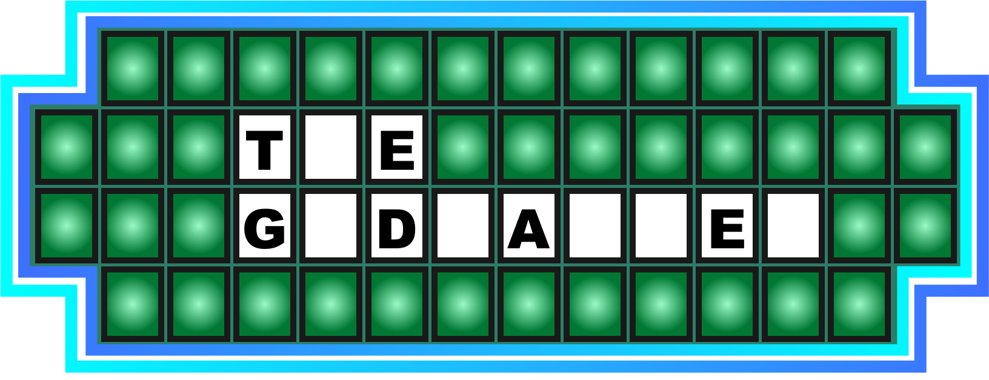
3. An epic movie

Slide 6
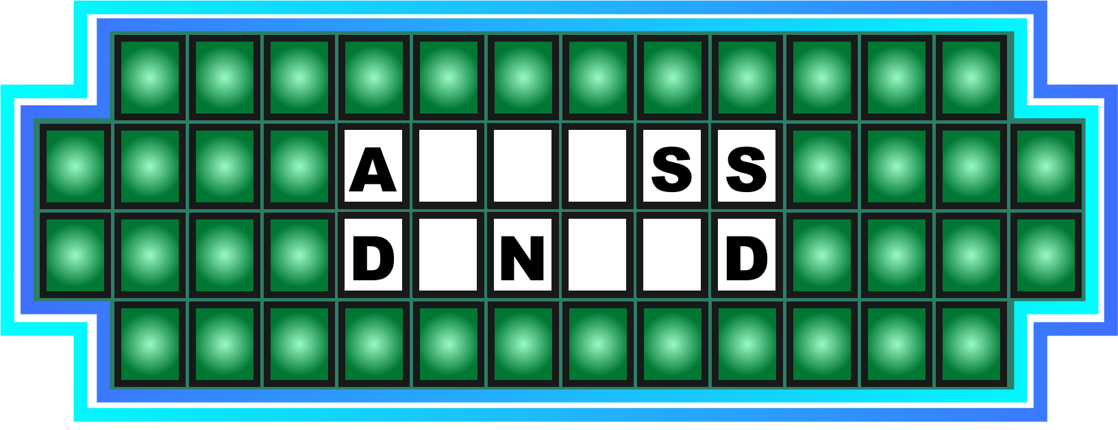
4. Please try again...

Slide 7
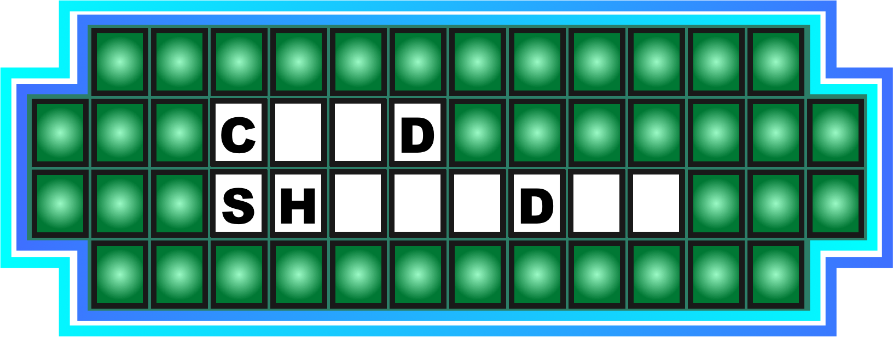
5. Not talking to you...

Slide 8
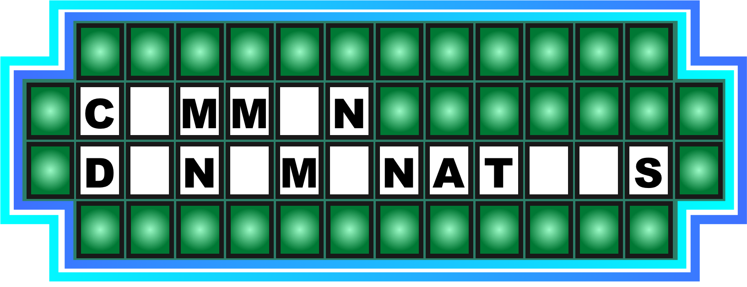
6. They share it

Slide 9
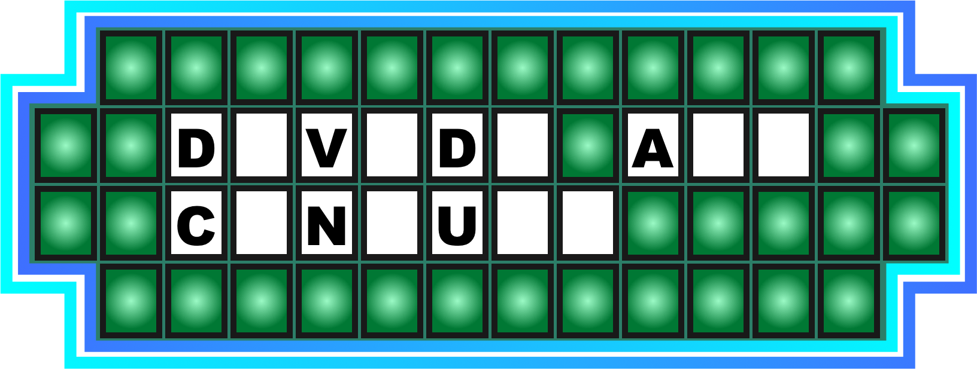
7. Split up and get it done

Slide 10
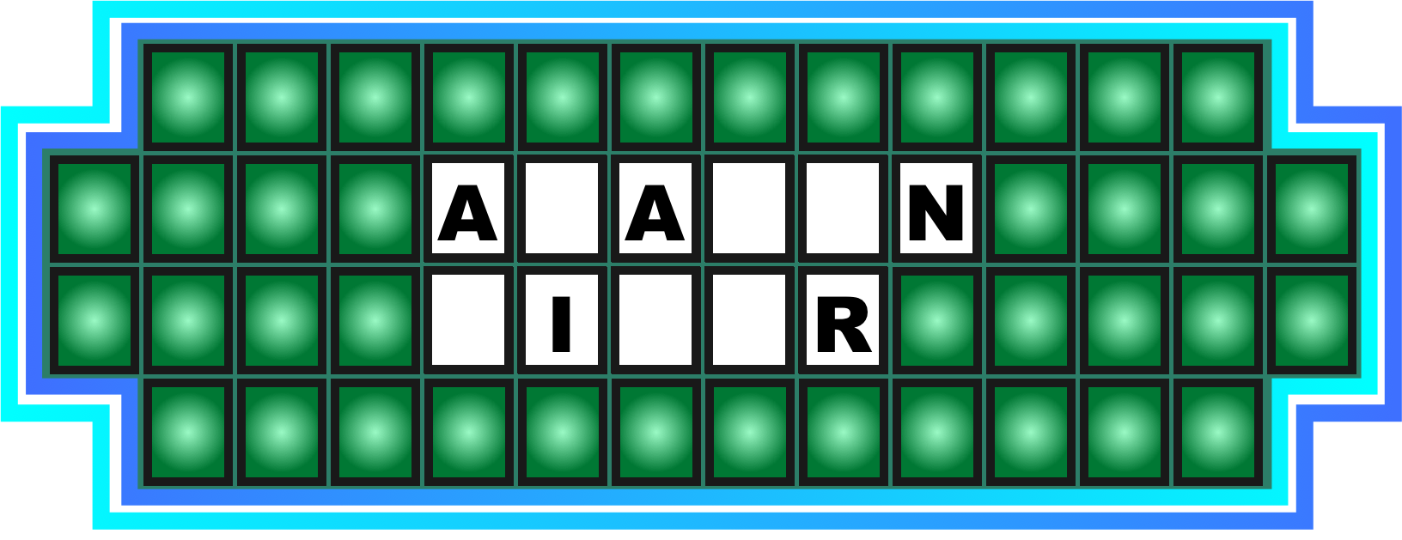
8. It has crocs

Slide 11
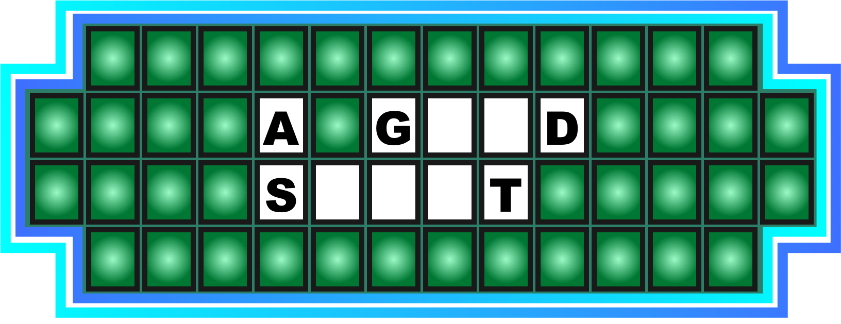
9. Gracious

Slide 12

10. A recent trend for many of us

Slide 14
1. A genius

Slide 15
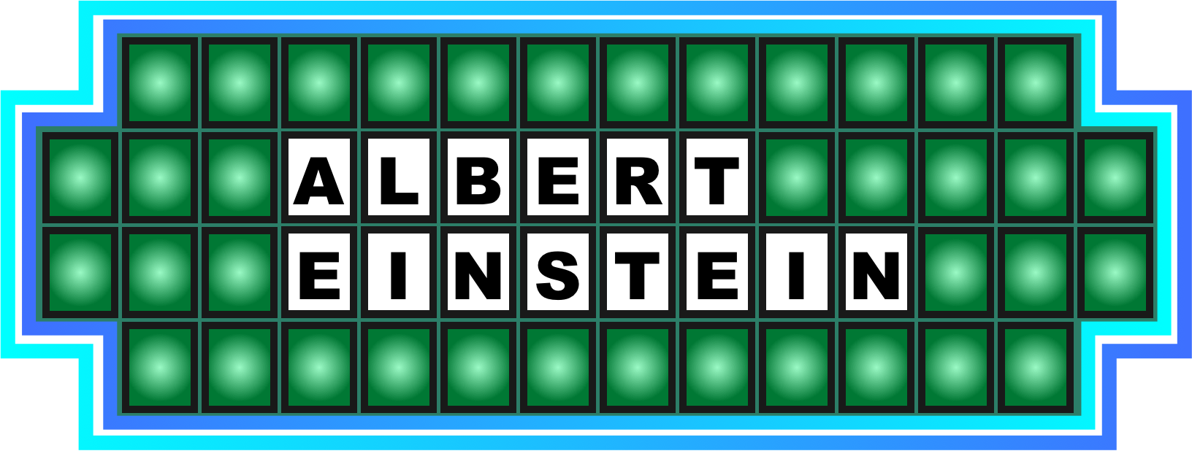
1. A genius

Slide 16
2. Crazy kid

Slide 17
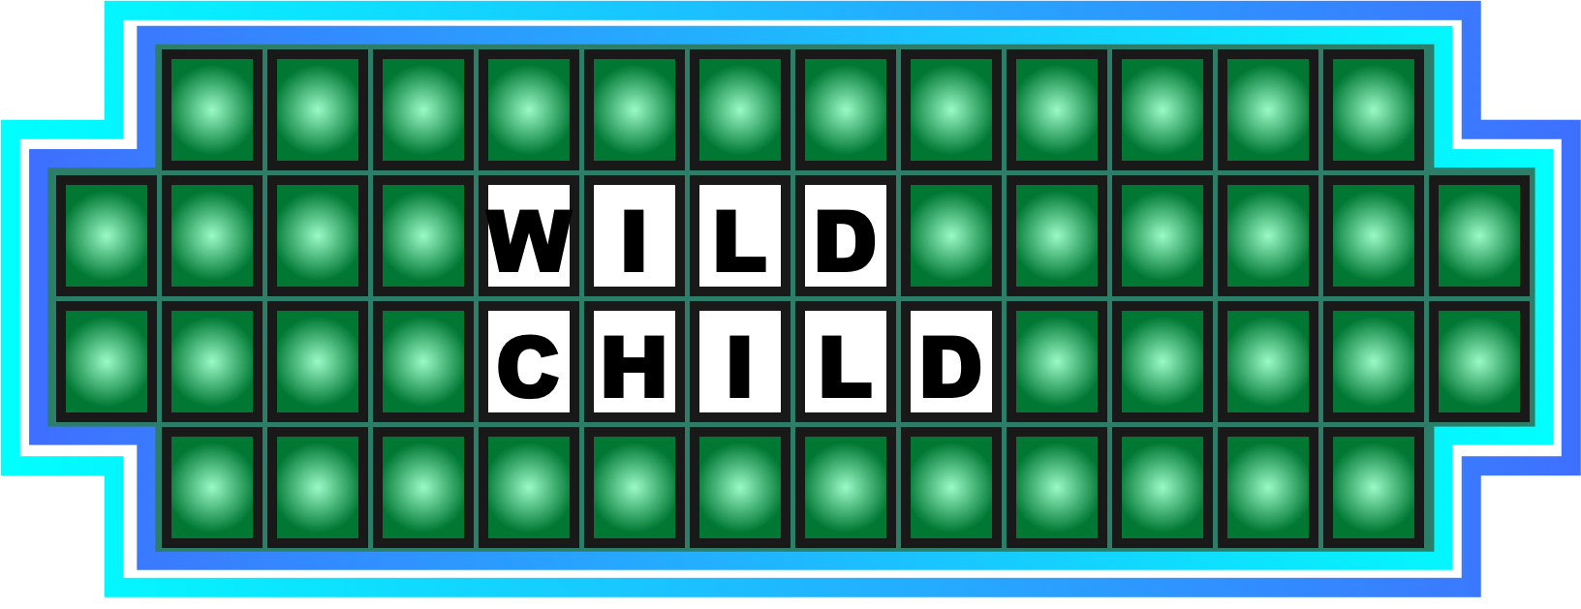
2. Crazy kid

Slide 18
3. An epic movie

Slide 19

3. An epic movie

Slide 20
4. Please try again...

Slide 21
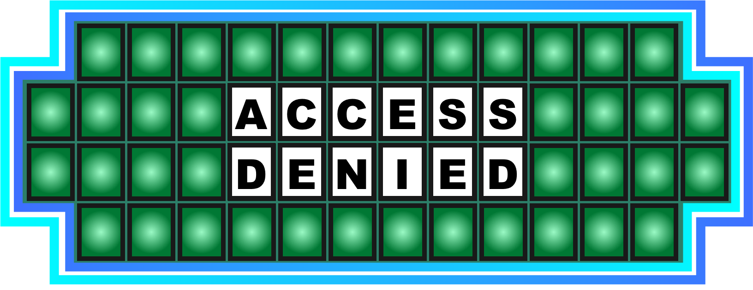
4. Please try again...

Slide 22
5. Not talking to you...

Slide 23

5. Not talking to you...

Slide 24
6. They share it

Slide 25

6. They share it

Slide 26
7. Split up and get it done

Slide 27

7. Split up and get it done

Slide 28
8. It has crocs

Slide 29

8. It has crocs

Slide 30
9. Gracious

Slide 31

9. Gracious

Slide 32
10. A recent trend for many of us

Slide 33

10. A recent trend for many of us

Slide 35

1. Peter waved goodbye to his dad, and then...

Slide 36

2. You'll see a lot of these at Comic Con

Slide 37

3. Nyccegirls take care of the planet

Slide 38

4. On their way to work

Slide 40
1. Peter waved goodbye to his dad, and then...

Slide 41

1. Peter waved goodbye to his dad, and then...

Slide 42
2. You'll see a lot of these at Comic Con

Slide 43

2. You'll see a lot of these at Comic Con

Slide 44
3. Nyccegirls take care of the planet

Slide 45

3. Nyccegirls take care of the planet

Slide 46
4. On their way to work

Slide 47

4. On their way to work

Slide 49


Slide 51
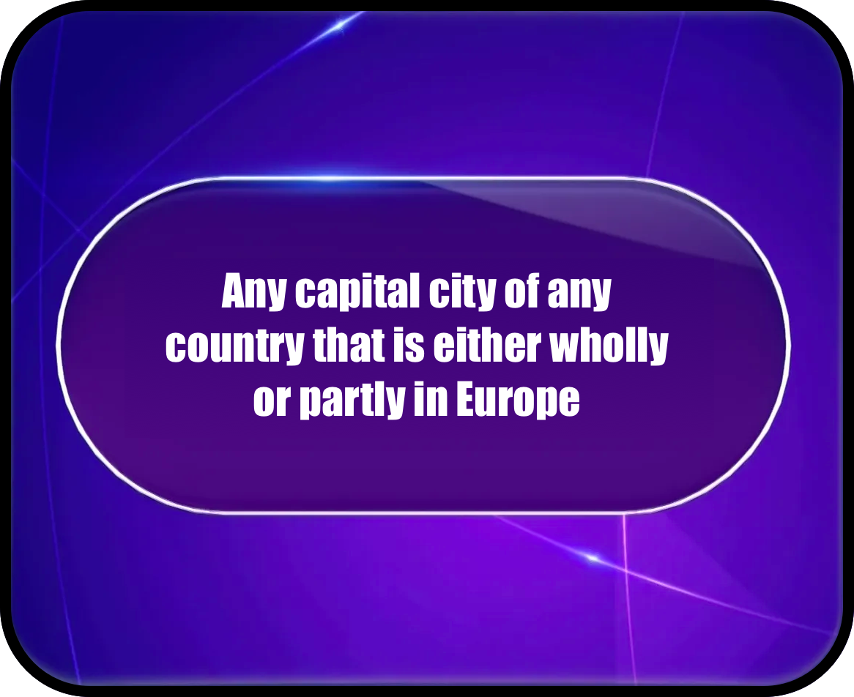

Slide 52
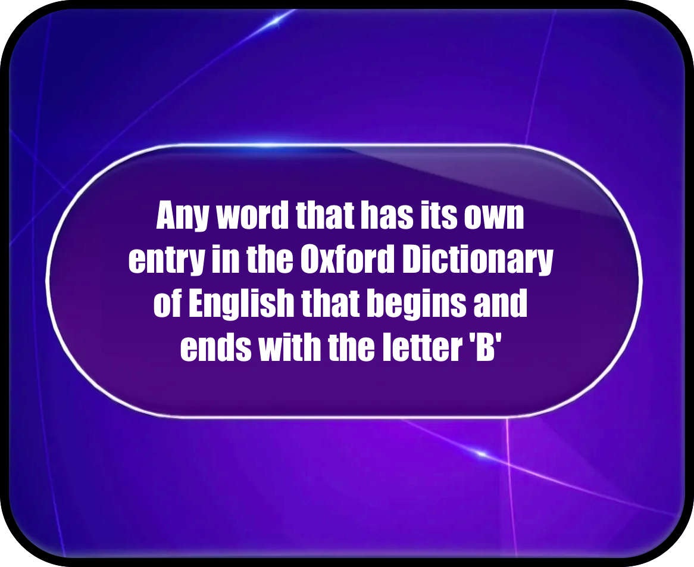

Slide 55
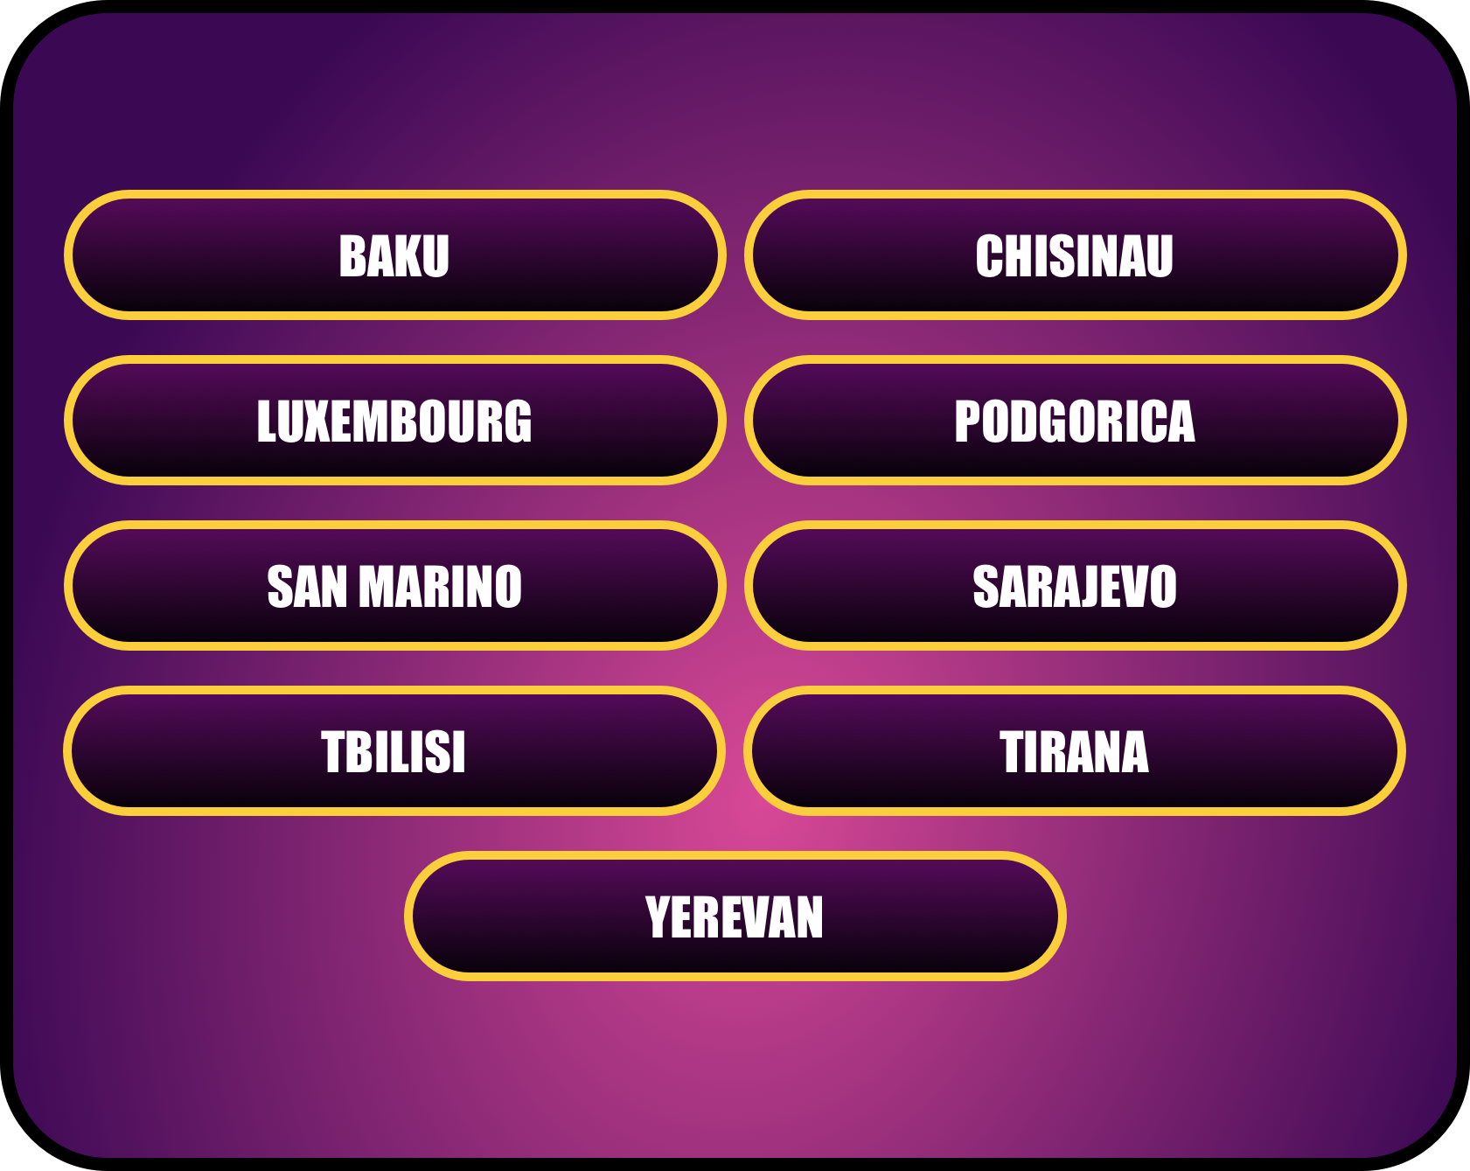

Slide 57
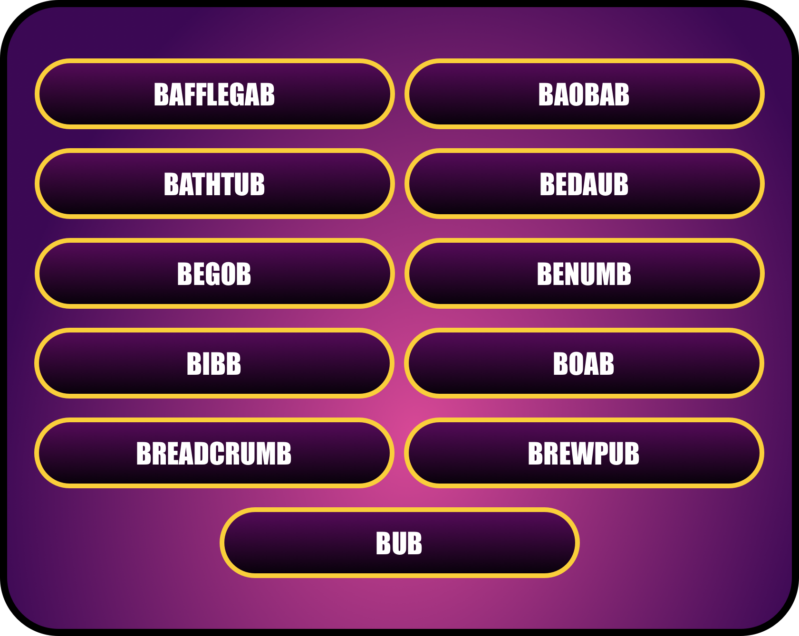

Slide 59
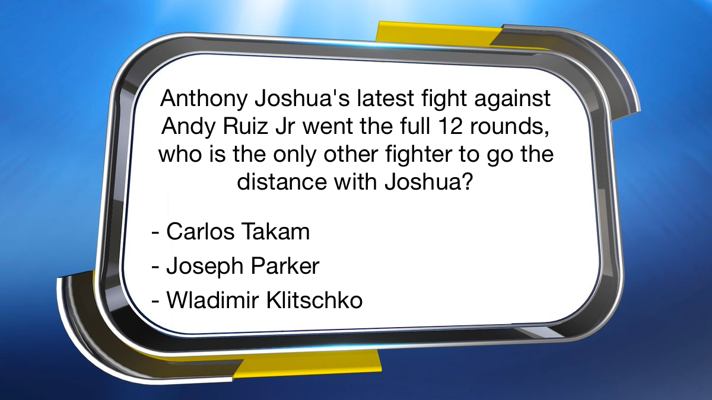

Slide 60
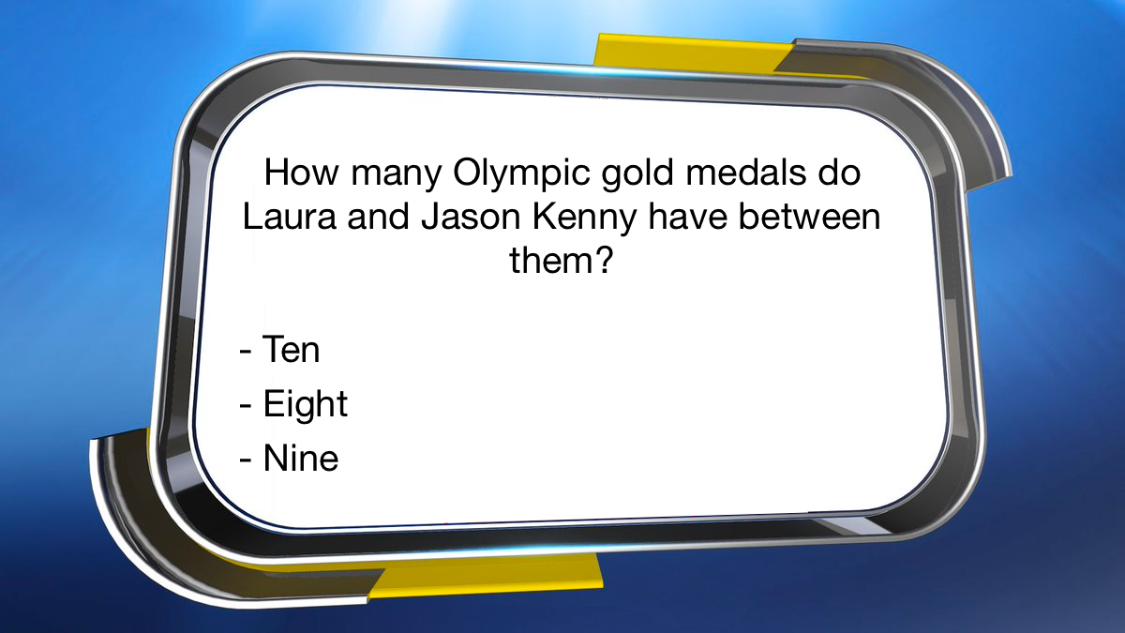

Slide 61
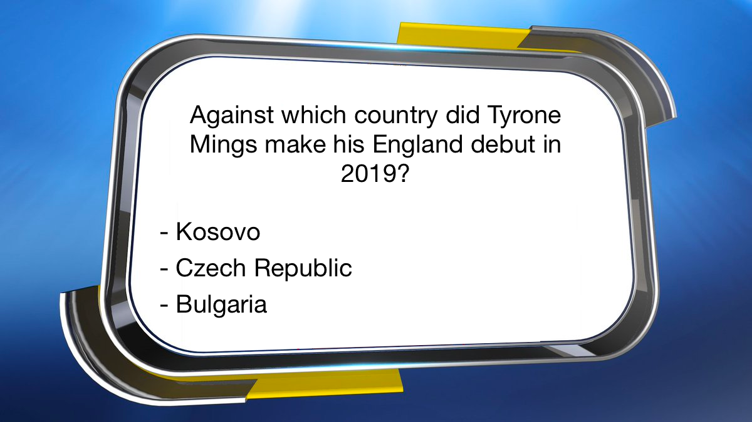

Slide 62
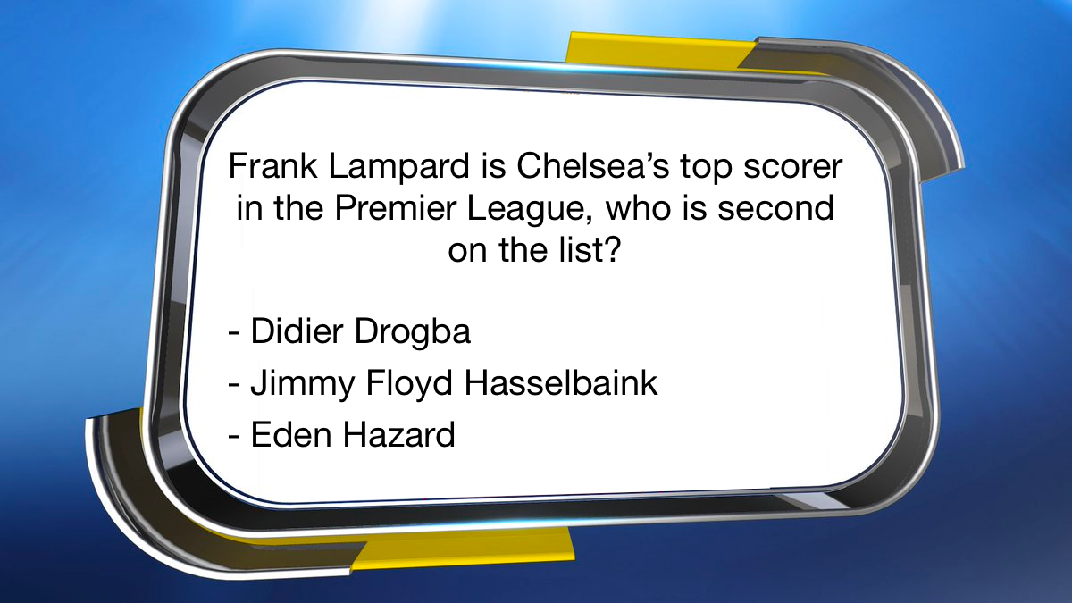

Slide 68
MASTERMIND

Slide 69
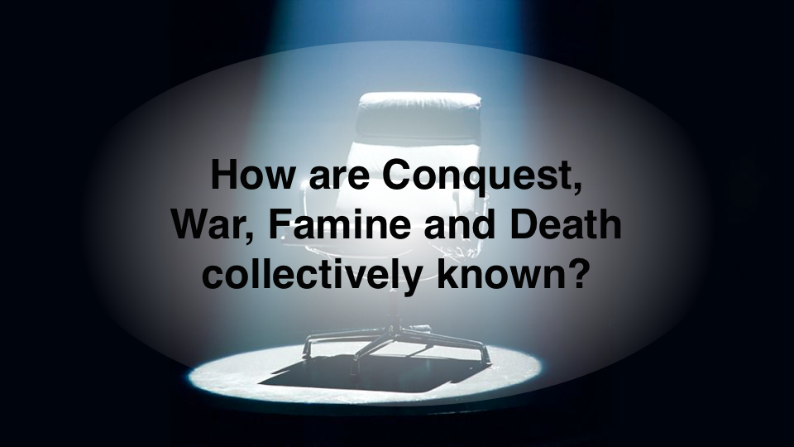

Slide 70
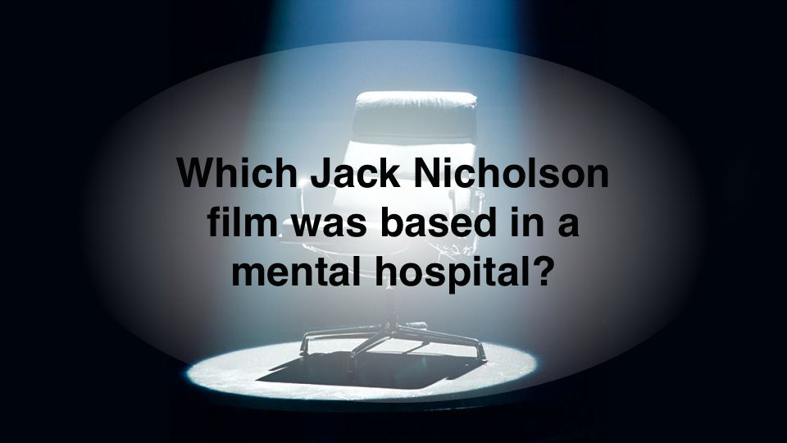

Slide 71
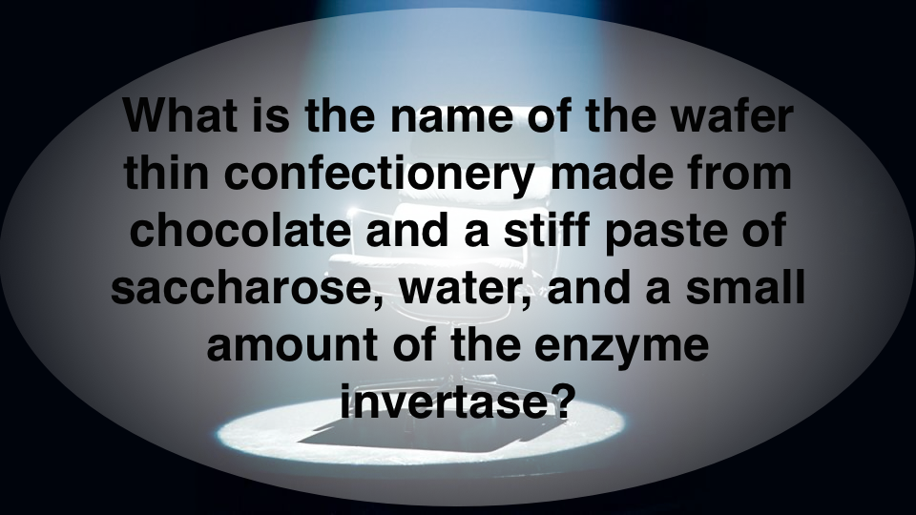

Slide 72
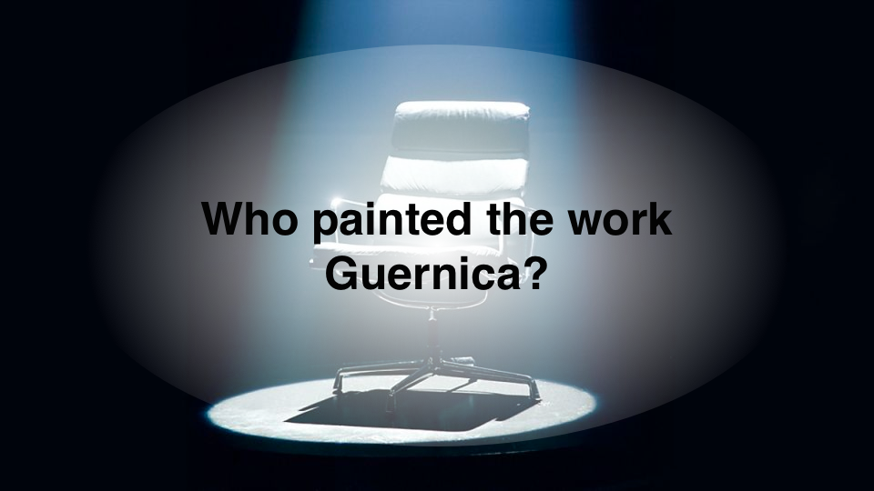

Slide 73
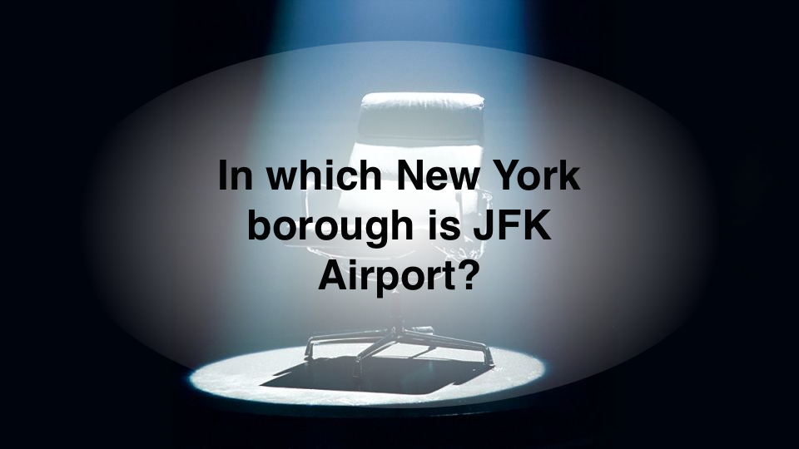

Slide 74
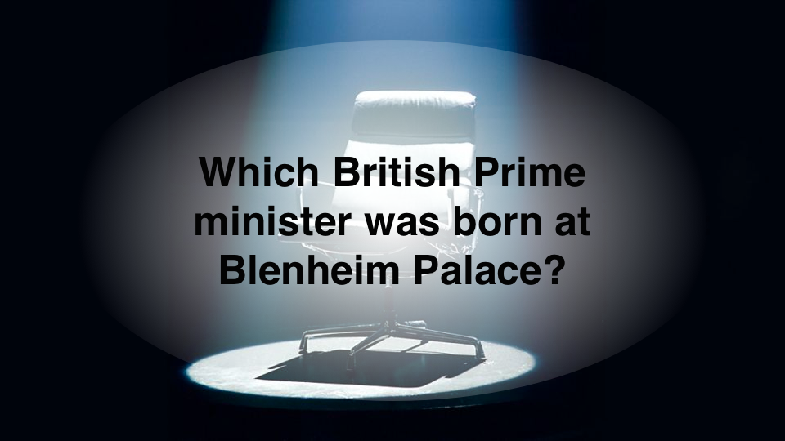

Slide 75
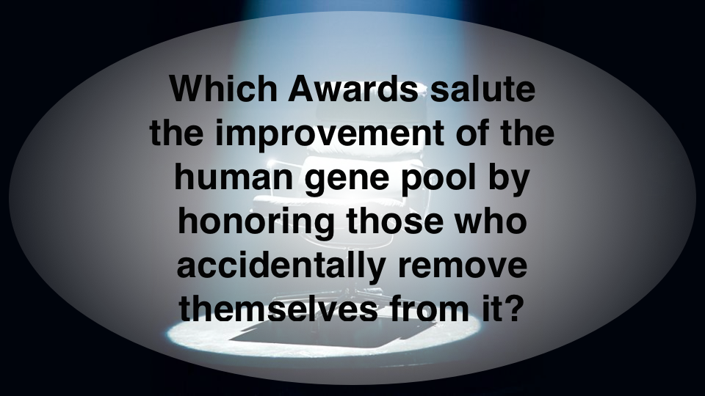

Slide 76
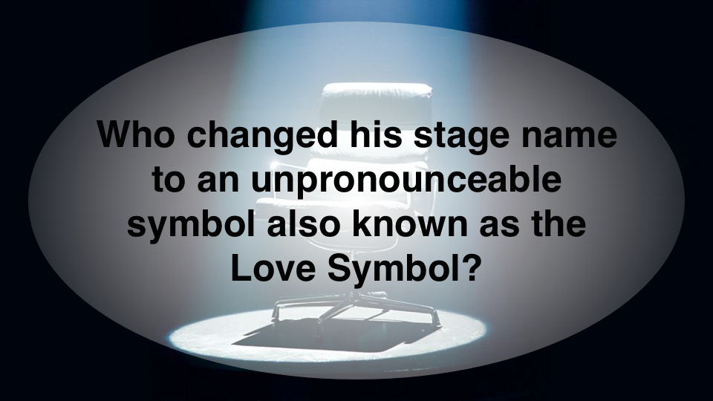

Slide 77


Slide 78


Slide 91


Slide 93
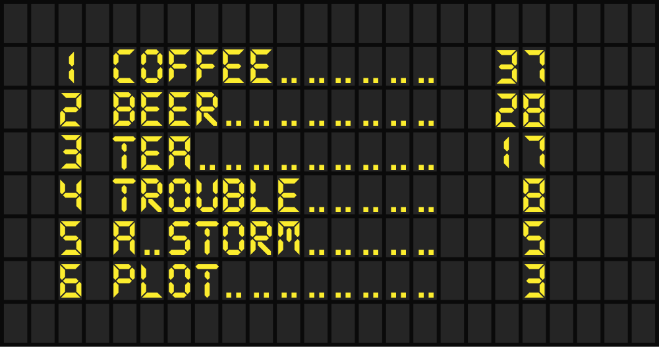

Slide 95

What links these 4 things?

Slide 96
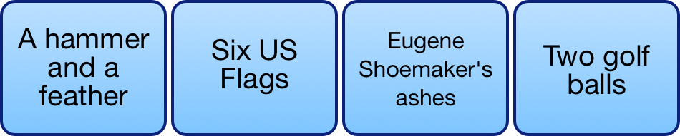
What links these four things?

Slide 98
What links these 4 things?
They are all airports

Slide 99
What links these four things?
They can all be found on the moon

Slide 100


Slide 101


Slide 103
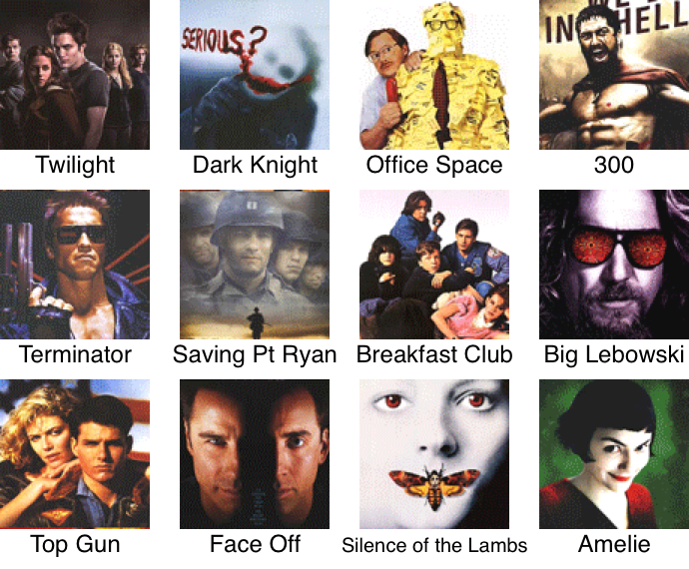

Slide 105
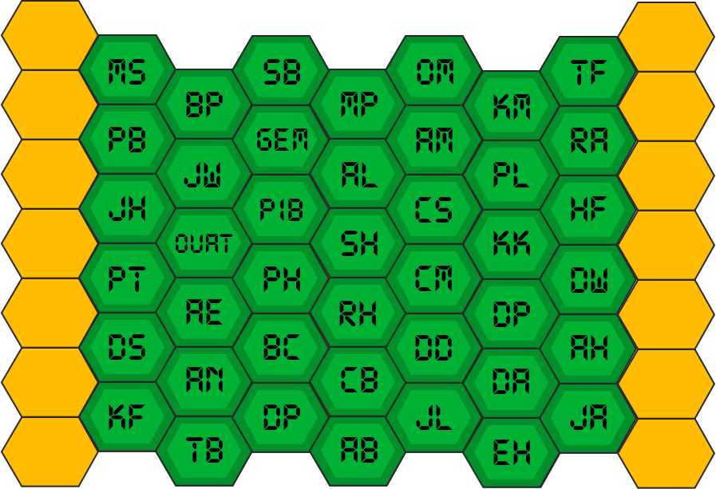

Slide 106
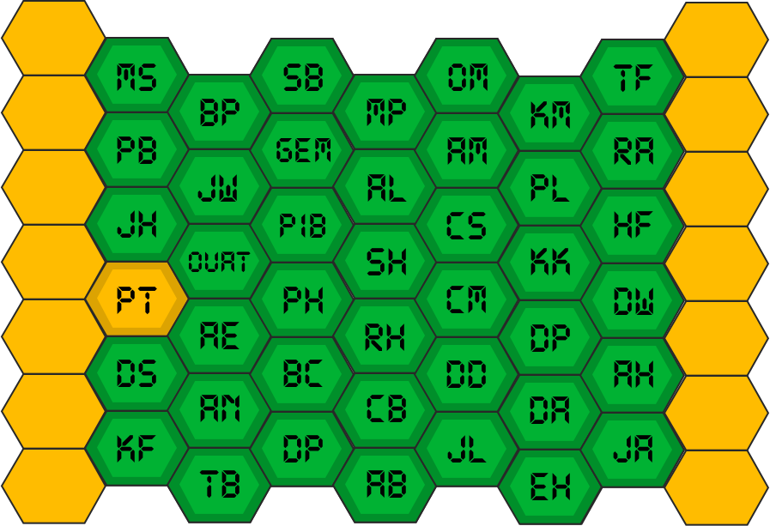

Slide 107
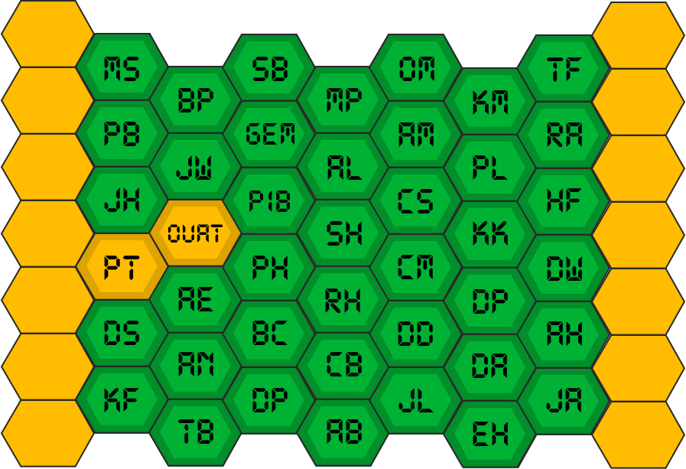

Slide 108
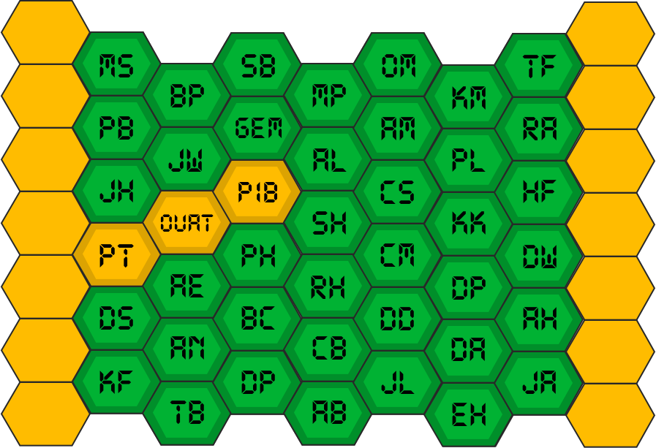

Slide 109
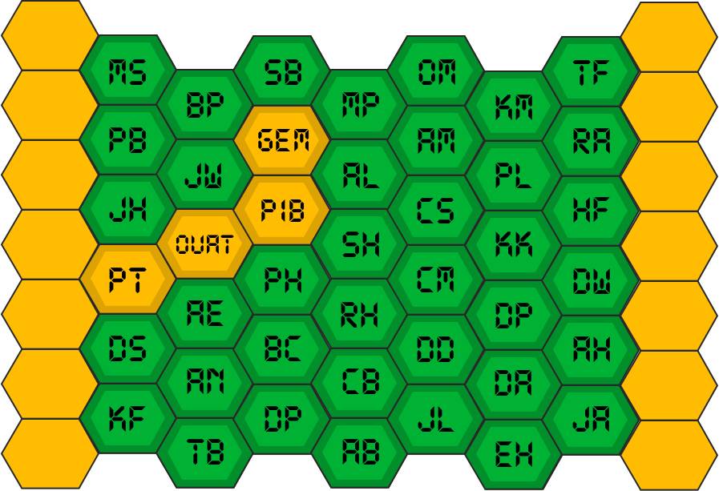

Slide 110
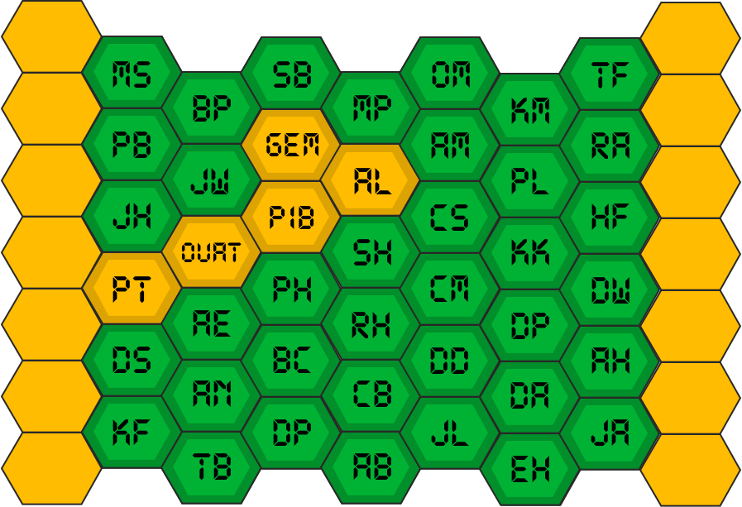

Slide 111
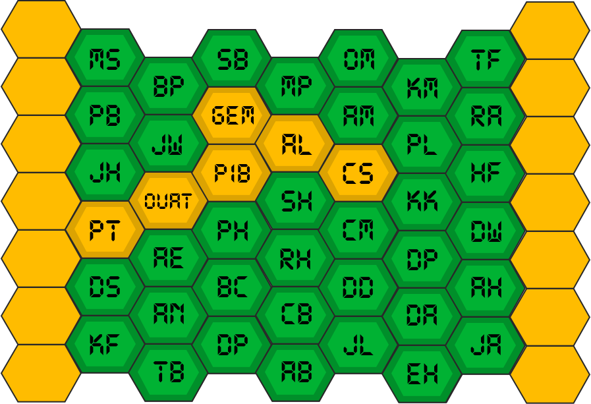

Slide 112
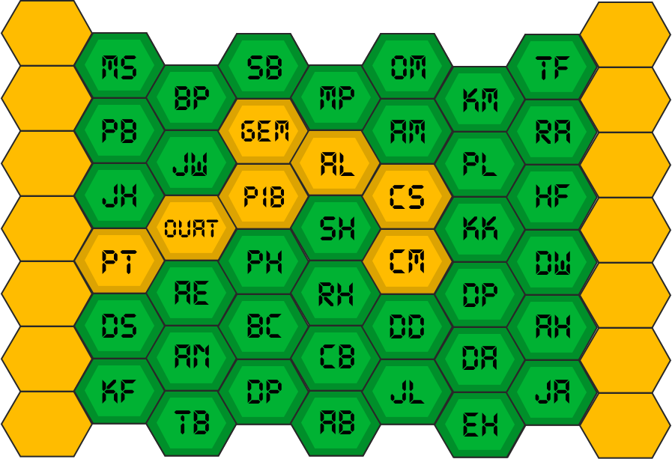

Slide 113
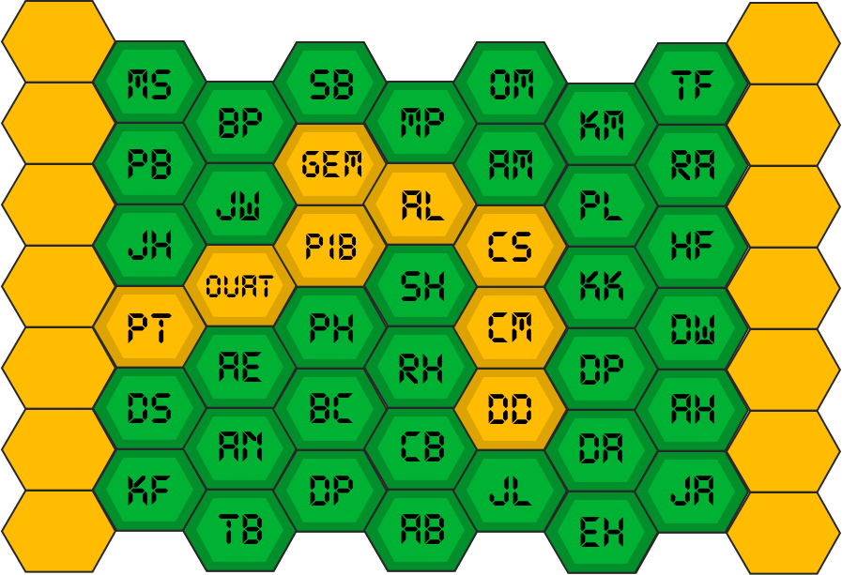

Slide 114
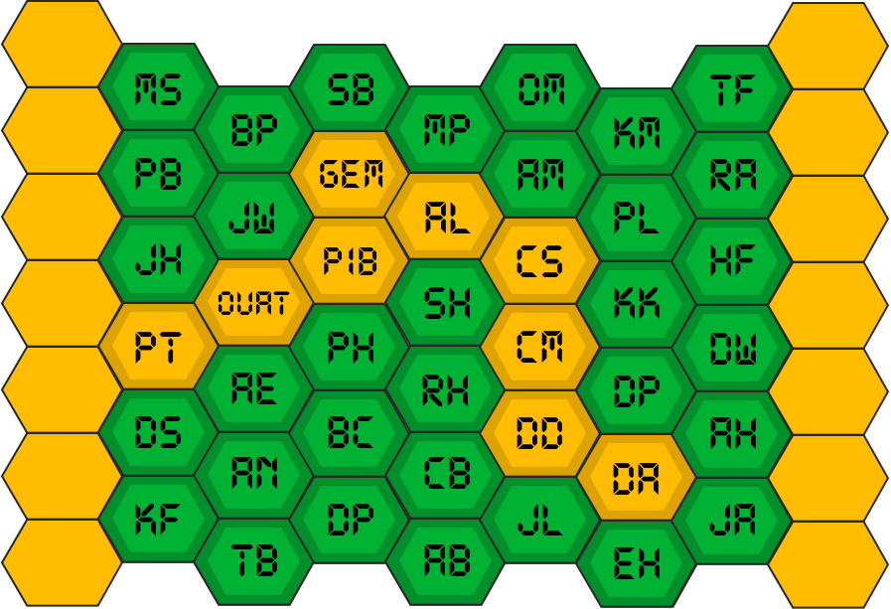

Slide 115
